Slide 1
ANALYSING AMAZON SALES DATA

Slide 2
Agenda
Introduction
Details of Data
Main KPIs
My Design
My interpretation
Tableau public link

Slide 3
Introduction
Amazon stands as a titan in the world of e-commerce, continuously shaping consumer behaviors and market dynamics.
With its vast array of products and services, Amazon has revolutionized the way people shop globally.
By analyzing trends, we aim to boost business strategies. We seek to unveil patterns, trends, and insights that can illuminate strategic pathways for enhanced business performance and customer satisfaction

Slide 4
Details of Data
Region
Country
Item Type
Sales Channel
Order Priority
Order Date
Order ID
Ship Date
It indicates whether the products were sold through online or offline channels.

Slide 5
Main KPIs
Units Sold
Unit Price
Unit Cost
Unit per profit
Total Revenue
Total Cost
Total Profit
unit price, unit cost, and unit profit of each product throughout the day to assess their individual financial performance
Revenue, Cost, and Profit of each product throughout the day to understand their individual financial performance

Slide 6
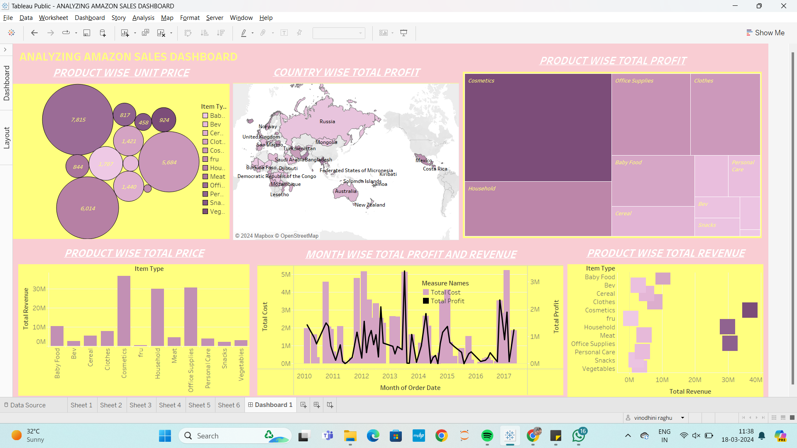
My Design:

Slide 7
My Interpretation:
Focus on Cosmetics: Since cosmetics are the top-selling product with higher unit price and profit, consider investing more resources in this product category, such as expanding the product line or enhancing marketing efforts to capitalize on its popularity.
Offline Sales Channels: As offline channels yield the highest profit, prioritize strategies to strengthen offline sales channels, such as improving distribution networks or enhancing in-store experiences to maximize profitability.
Maximize Profitable Products: Identify other high-profit products besides cosmetics and focus on maximizing their sales to further boost overall profitability.
Target Pakistan Market: Given that Pakistan shows significant sales for cosmetics, tailor marketing campaigns and product promotions specifically for this region to further tap into the demand.
Analyze July 2012 Performance: Investigate the factors contributing to the higher total profit in July 2012. Determine whether it was due to specific promotions, market conditions, or other factors, and replicate successful strategies in future planning.

Slide 8
Tableau public link:
https://public.tableau.com/views/ANALYZINGAMAZONSALESDASHBOARD/Dashboard1?:language=en-US&publish=yes&:sid=&:display_count=n&:origin=viz_share_link

Slide 9
Thank you

